Slide 1
DEMO: How to set up and use AI agents to suggest data quality rules
Streamlining rule creation with AI, to ensure accuracy and consistency across your data

Slide 2



Session Goal
This session is part of a series of practical trainings on using AI Agents for data management.
Your CluedIn Trainer will demonstrate how to use the “Suggest data quality rules” skill to identify rules tailored to a specific dataset.
We’ll begin with a simple example of determining potential data quality rules and build toward more complex scenarios in upcoming sessions.
Note: This session is designed to develop practical experience with AI agents. For a full overview of AI agents, refer to the “CluedIn AI agents” session.

Slide 3


The data we’ll use
We are working with NorthStar Retail, a fictional international retailer. The challenge? We want to ensure that incoming order data is accurate, consistent, and complete.
Order data:
Invalid or inconsistent order statuses
Negative order amounts
Dates in mixed or invalid formats
Missing customer references
Non-standard currencies or payment methods

Slide 4
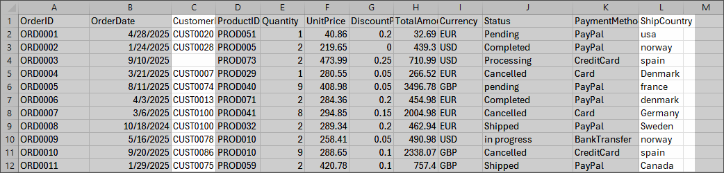

Slide 5
DEMO: How to set up and use AI agents to suggest data quality rules

Slide 6
Demo summary
You’ve seen how to:
Use AI agents to suggest context-specific data quality rules
Interpret results and decide when to accept or reject them
Outcome:
You now understand how to leverage AI agents to effectively improve data quality at scale
Next step:
Pause the video and replicate the process.

Slide 7

Recommended materials
Before you get down to practice, make sure you are comfortable with data ingestion, mapping, and rules.
Ingest data | CluedIn Documentation
1.1. Ingestion | CluedIn Documentation
Rules | CluedIn Documentation

Slide 8
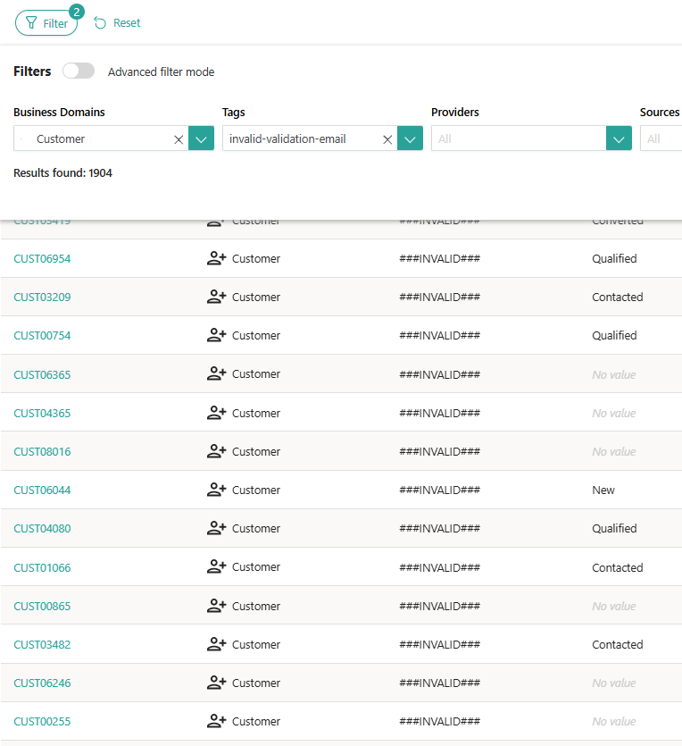


Learn more about AI agents in our documentation portal.
Next session: Explore more advanced used cases.
What’s next?

